Slide 1
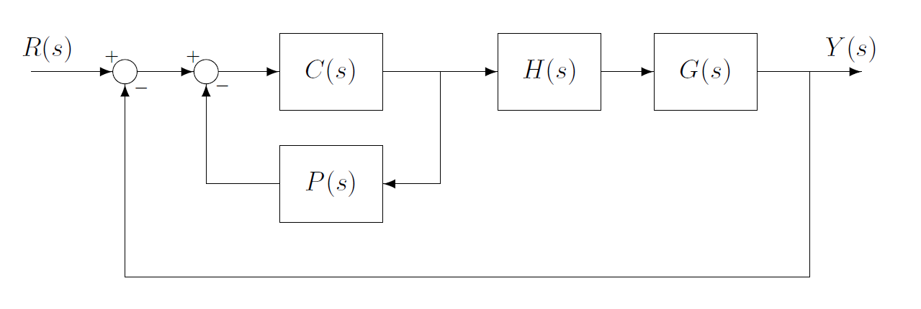



$$e=Rf−y$$
$$U\left(s\right)=e−C+P$$
e
ui
$$CP=\frac{Cz∗Pz}{1+Cz∗Pz}$$

Slide 2







$$e=Y −R_{f}$$
$$e_{c}=e−p$$
$$u=C∗e_{c}$$
e
$$e_{C}$$
$$u$$
$$p$$
$$p=P∗u$$

